Slide 1
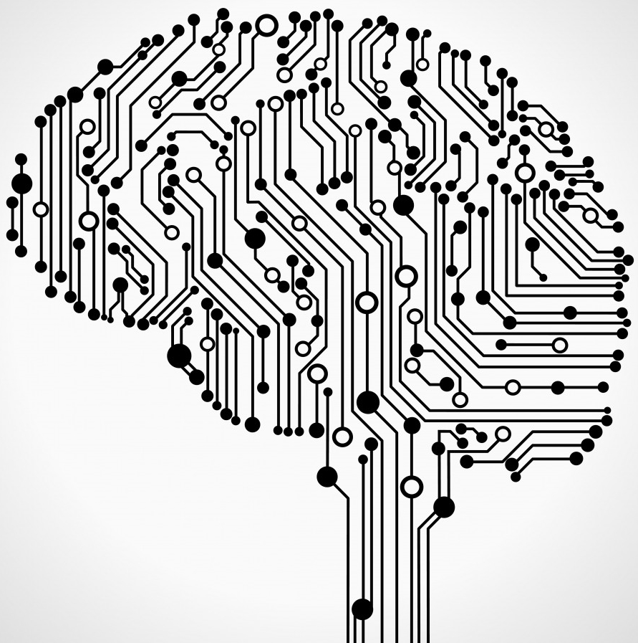
Neural Networks and AI, A Winter Classic
Ali Zaidi
Microsoft AI and Research
@alikzaidi

Slide 2
Agenda
AI, Representation Learning, and Deep Learning
Microsoft Cognitive Toolkit
Microsoft AI Portfolio

Slide 3
Brief History

Slide 4
Pretensions to Thinking
“The Analytical Engine has no pretensions whatever to originate anything. It can do whatever we know how to order it to perform… Its province is to assist us in making available what we are already acquainted with.”

Slide 5
Learning in Complex Environments
Goal: produce systems that can learn and build intelligence from observations in complex environments
Learning:
Acquisition of knowledge about the state of the world (Kupfermann, 1985)
Search and inference
Memorization?
Learning is an adaptive change in behavior caused by experience (Shepherd, 1988)
Stochastic environments
Empirical Inference

Slide 6
Cognition and the Brain
“If the brain was simple enough to be understood - we would be too simple to understand it!” – Marvin Minsky
Associationism
Humans learn through association
400BC-1900AD: Plato, David Hume, Ivan Pavlov
Mid 1800s: The brain is a mass of interconnected neurons
Many neurons connect in to each neuron
Each neuron connects out to many neurons

Slide 7
Connectionism
Alexander Bain, philosopher, mathematician, logician, linguist, professor
1873: The information is in the connections
The mind and body (1873)
Neurons excite and stimulate each other
Different combinations of inputs can result in different outputs

Slide 8
The First Wave: Cybernetics (40s – 50s)
Norbert Wiener, Cybernetics or Control and Communication in the Animal and the Machine, 1948.
The start of information processing
Study of control and information processing rather than energy processing in machines and animals
Macy Conferences 1946 – 1953
Birth of Cybernetics and Cognitive Science

Slide 9
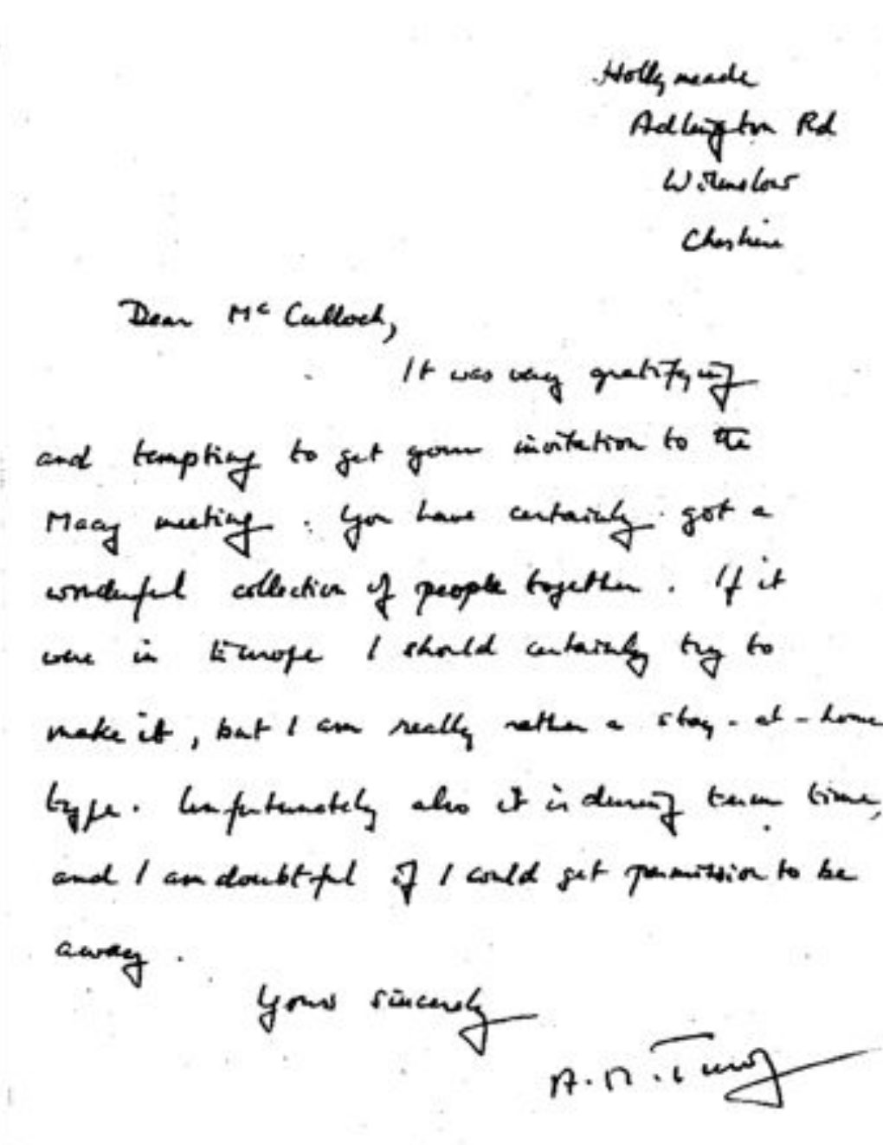

Slide 10
First Rise of Neural Networks (1950s)
McCulloch-Pitts formalized “formal neurons” which could emulate a Universal Turing machine (1943)
Computation
Rosenblatt – the perceptron as a probabilistic model for information storage (1958)
Perceptron Convergence Theorem (1962)
If the problem is computable, perceptron algorithm converges in finite time

Slide 11
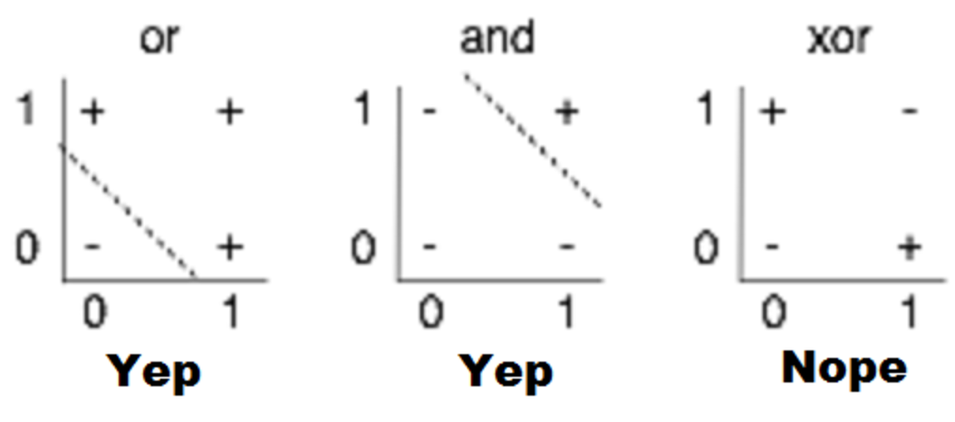
First Winter
Minsky and Papert, 1969
Perceptrons could not provide solutions for some very simple, non-pathalogical problems
XOR
Single neuron was not enough
Individual elements are weak computational elements
Networked elements were required
Multi-layer perceptron
A multi-layer perceptron is a universal (Hornik, Stinchcombe and White, 1989)

Slide 12
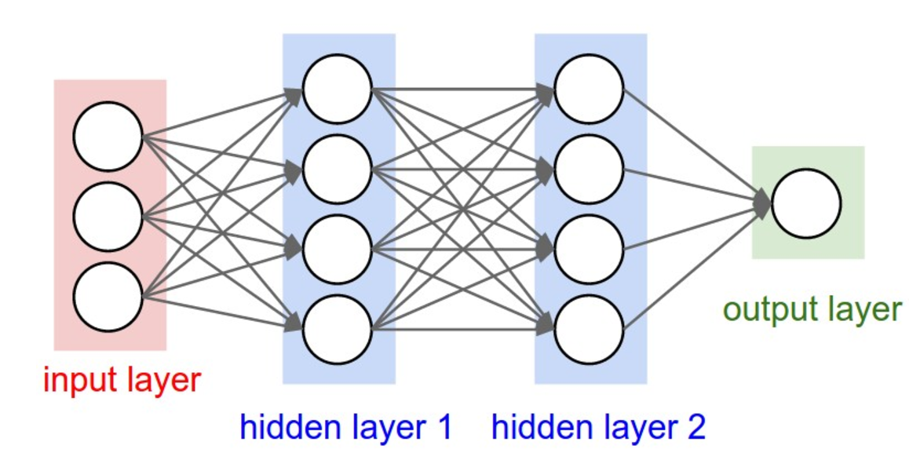
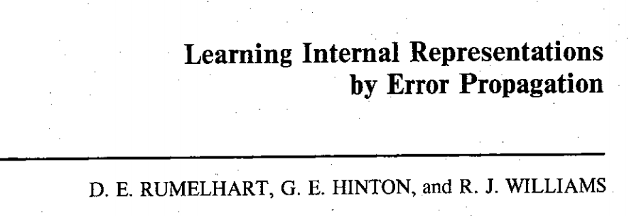
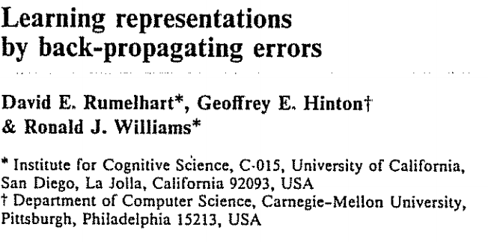
Backpropagation
Rosenblatt’s algorithm for computing perceptron’s did not naturally extend to multi-layer models
Paul Werbos describes how to use backpropagation specifically for optimizing neural networks (1974)
Rumelhart, Hinton and Williams publish backpropagation algorithm in Nature (1986)

Slide 13
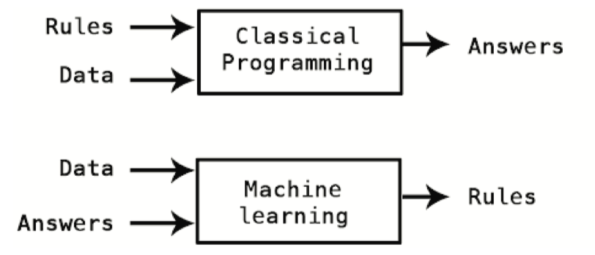
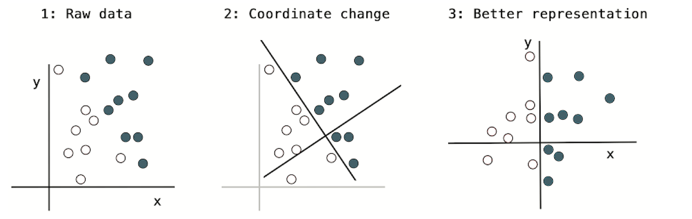
Representation Learning, Machine learning and AI

Slide 14
Artificial Intelligence, Representation Learning and Deep Learning
Deep Learning
Machine Learning
AI
Representation Learning
Based on Goodfellow, Bengio, Courville. Fig. 1.4

Slide 15
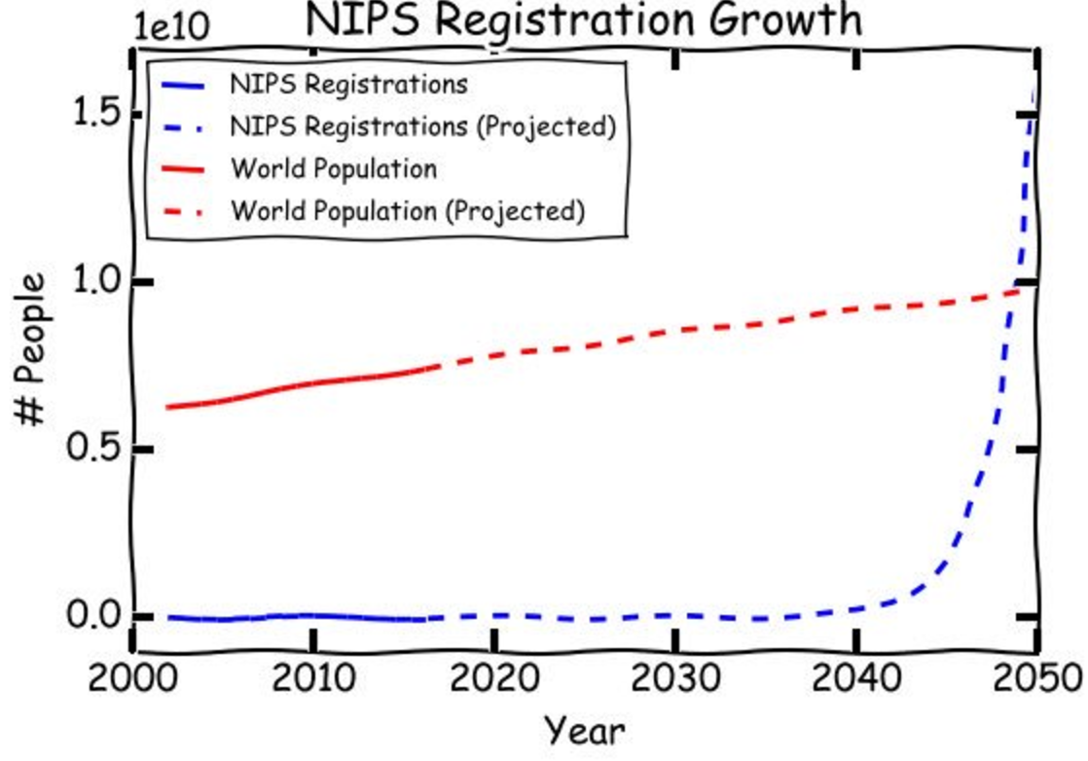
Neural Hype

Slide 16
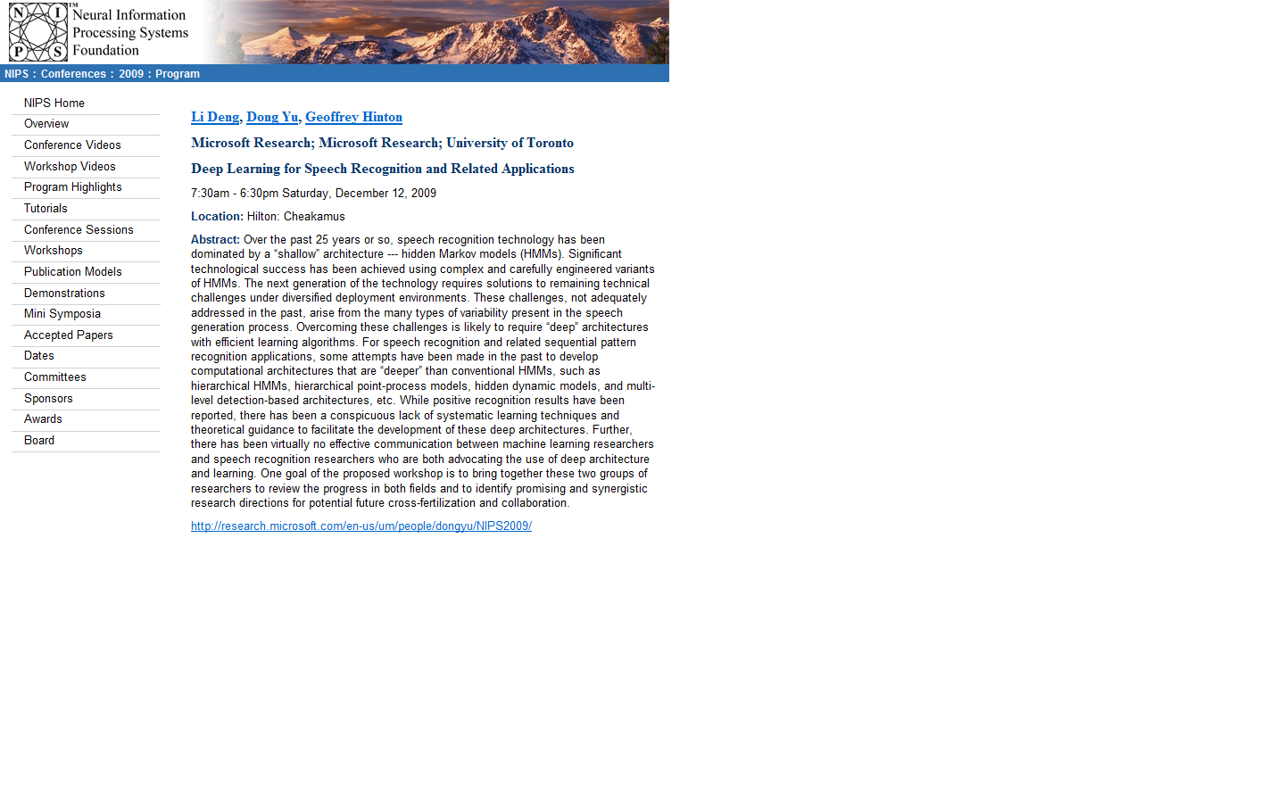

Slide 17
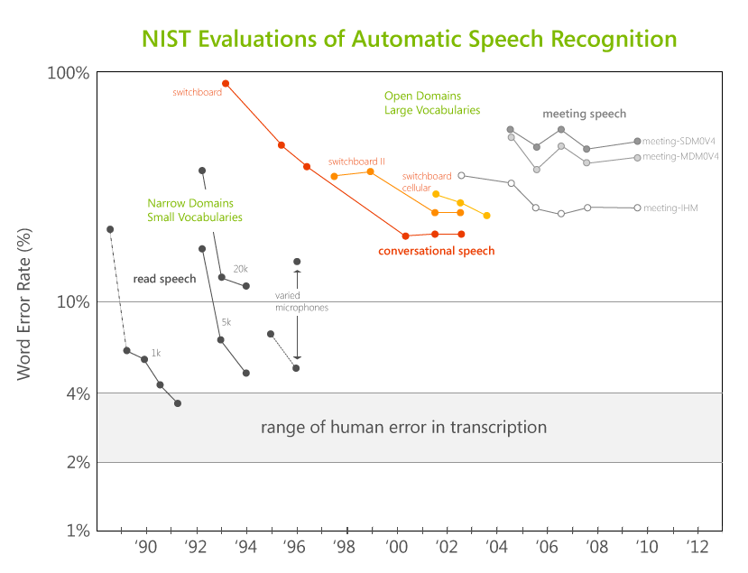

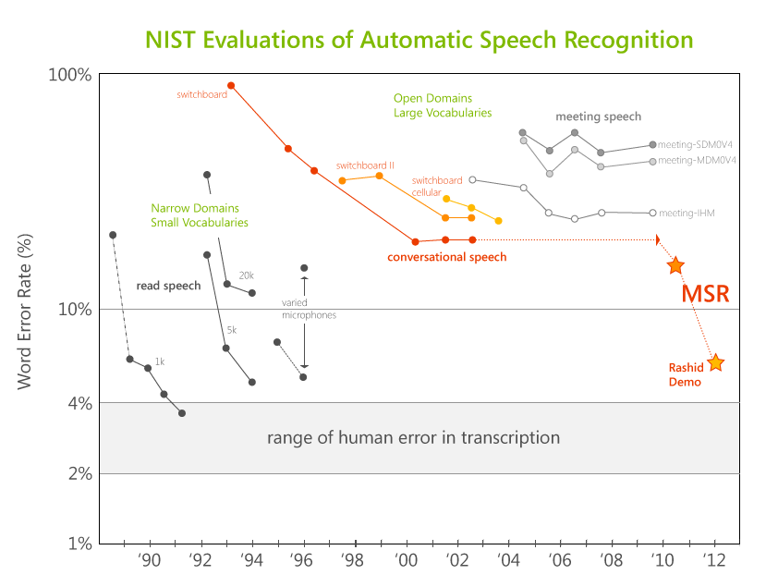
NIST Evaluations of Automatic Speech Recognition
After no improvement for 10+ years by the research community…
…MSR reduced error from ~23% to <15% (and under 7% for Rick Rashid’s demo)!
Notes:
These advances have been achieved through the application of deep neural networks. We will explain a little bit about how DNNs work and why they might be important, but first let’s take a look at the stunning impact on speech recognition.
The US government has been funding R&D in speech recognition for over 25 years, and as part of its research programs conducts tests of the effectiveness of the best systems. This graph shows the results of these tests, from 1988 to 2011, with the measure of effectiveness being the Word Error Rate (WER). In the early years, the best speech systems worked only in very narrow domains, such as air travel planning. While narrow, very good performance could be achieved, on par with human capability.
But in open-domain situations, such as meeting transcription and television news captioning, the results have not been so good. Consider the very important Switchboard benchmark, which today is the standard used by the research community. In the late 1990’s there was good progress, but for the past decade this plateaued and in all systems the research showed essentially no progress.
In joint research with the University of Toronto, by applying deep learning to speech recognition we achieved last year an astounding improvement in error rate. This made all the difference for the demo in China. In fact, for Rick’s speech, the speech recognition system exhibited an error rate of less than 7%!

Slide 18
Unreasonable Effectiveness of Data and Deep Architectures
performance
neural networks
traditional learners
training data
Revisiting Unreasonable Effectiveness of Data in Deep Learning Era, Google

Slide 19
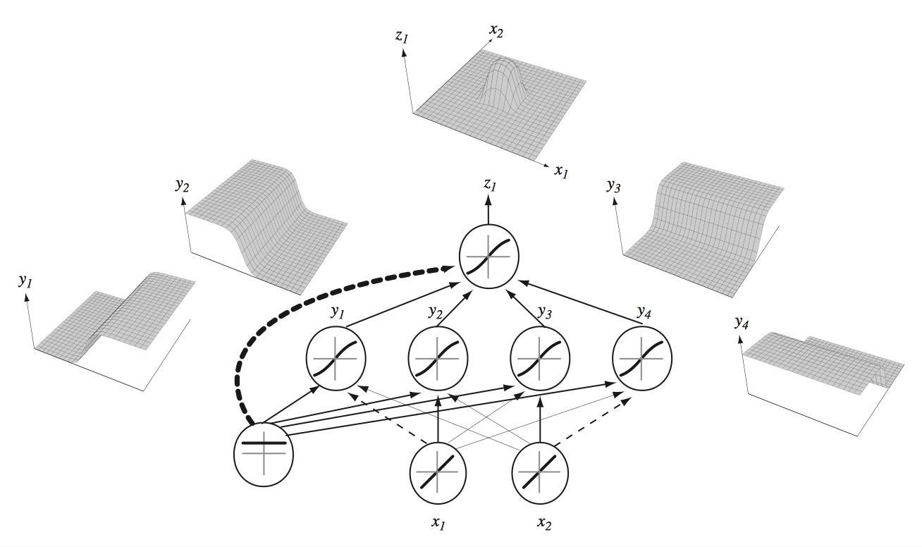
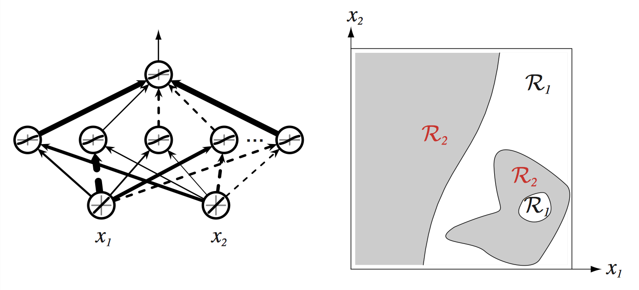
Capacity of Neural Networks – Universal Function Approximators
Even with a single hidden unit, a neural network can approximate any continuous function arbitrarily well.
Universal approximation theorem (Hornik, 1991)
Radford Neal (1996) shows that such a network converges to a Gaussian process prior over functions.
So what? Is there an actual learning algorithm?
Pascal Vicent

Slide 20
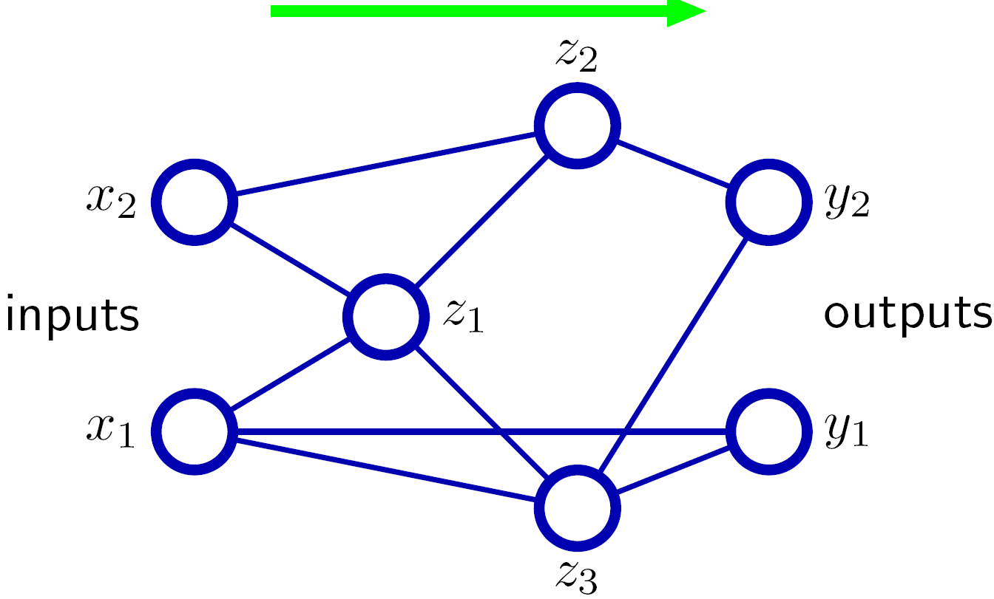
Forward-propagating local input signals
Forward propagation gives all the a’s and z’s

Slide 21
Back-propagating local error signals
t₂
t₁
Back-propagation gives all the δ ’s

Slide 22
Deep Convolutional NN for Image Recognition
CNN: local connections with weight sharing;
pooling for translation invariance
2012-2013
Fully connected
Fully connected
Fully connected
earlier
Convolution/pooling
SVM
Convolution/pooling
Pooling
Convolution/pooling
Histogram Oriented Grads
Convolution/pooling
Image
Convolution/pooling
Raw Image pixels
Notes:
Caltech 256 : 256 categories (16)
ImageNet: 22000 categories (148)

Slide 23
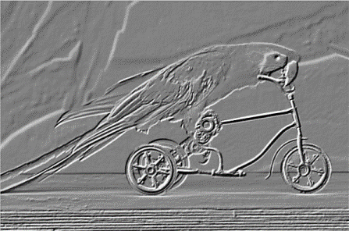
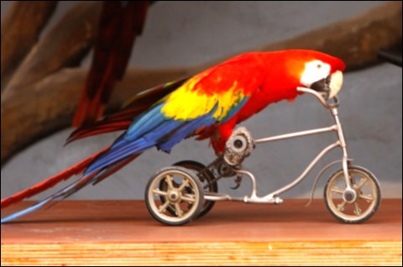
Learning Hierarchies with CNNs
Learning Hierarchies with CNNs
Pooling
Convolution
Image

Slide 24
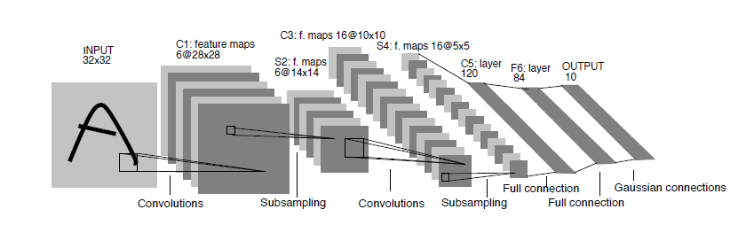
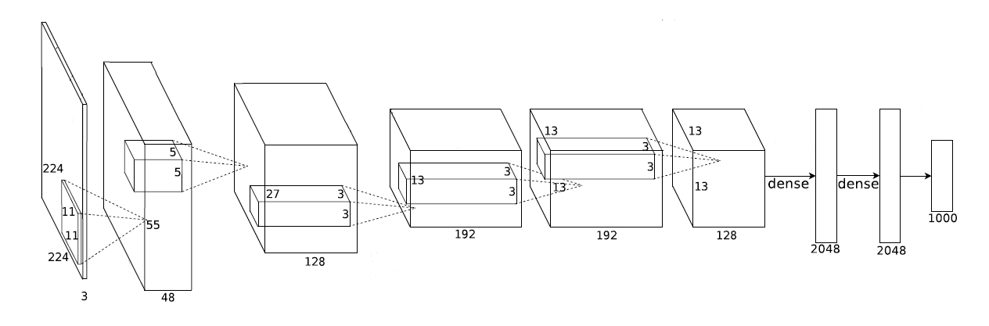
Deep Convolutions
Deep Convolutions
LeCun et al., 1998
AlexNet, 2012
Output
90% parameters

Slide 25
ImageNet 1K Competition (Fall 2012)
Deep CNN
Univ. Toronto team

Slide 26
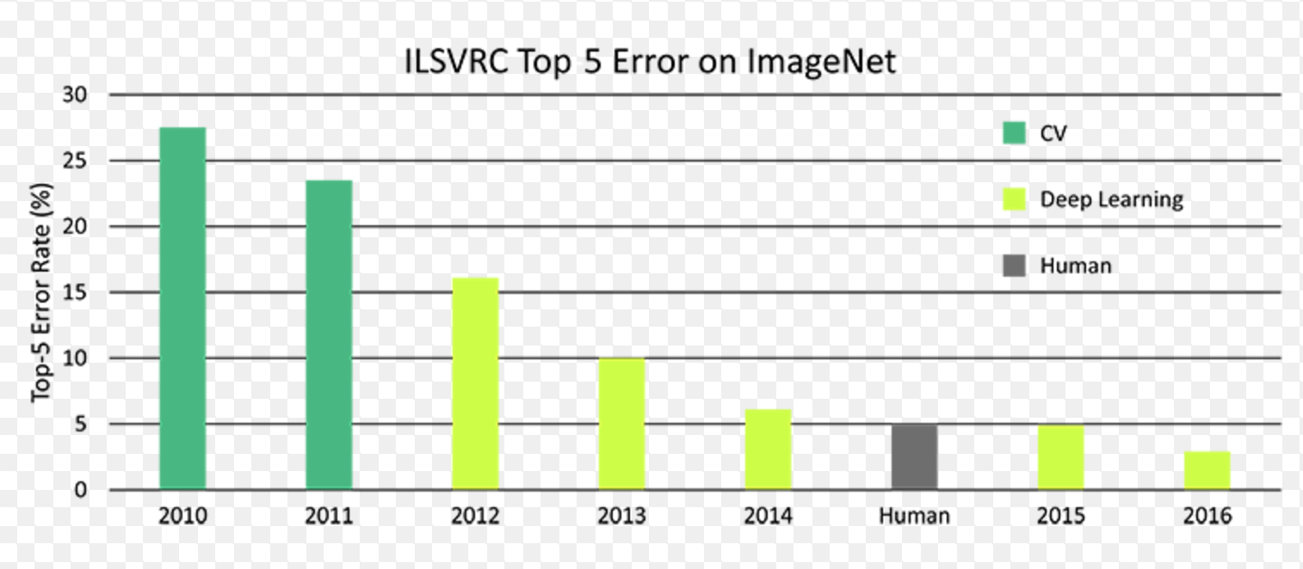
ImageNet

Slide 27
Deep Learning Frameworks

Slide 28
Deep Learning Frameworks
Framework | Definition | Sponsor | Additional APIs
CNTK | Static Computational Graph | Microsoft | Brainscript, Python, Keras
TensorFlow | Static Computational Graph | Google | Keras, TFSlim, TF Estimators, TFLearn, Sonnet, Tensor2Tensor
Caffe2 | Static Computational Graph | Facebook
PyTorch | Dynamic, Define and Run | Facebook
MxNet | Static Computational Graph | Apache, Amazon | Gluon, MxNet

Slide 29
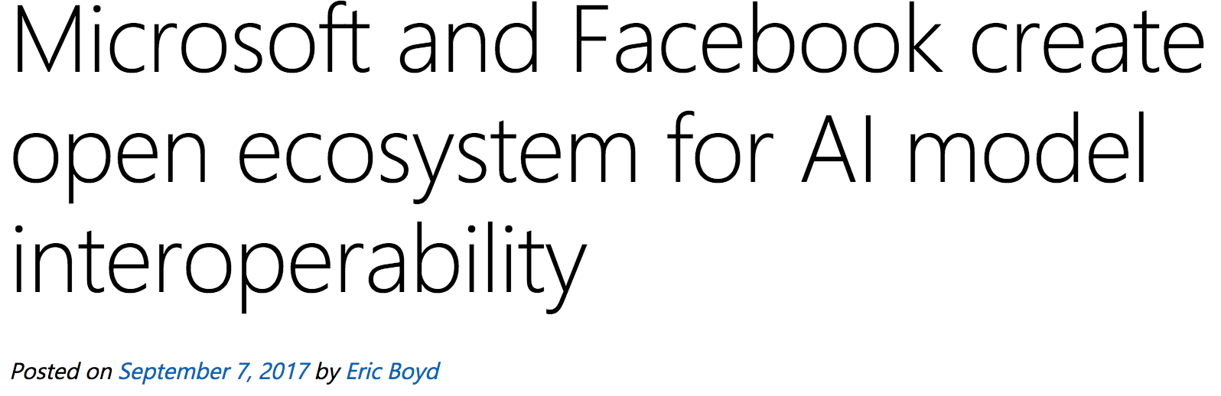
Intermediate Representations
https://github.com/onnx/onnx

Slide 30
What is the Microsoft Cognitive Toolkit

Slide 31

Microsoft Cognitive Toolkit
Microsoft’s open-source deep-learning toolkit
https://github.com/Microsoft/CNTK
Created by Microsoft Speech researchers (Dong Yu et al.) in 2012, “Computational Network Toolkit”
Open sourced on CodePlex in Apr 2015
On GitHub since Jan 2016 under MIT license, and renamed to “Cognitive Toolkit”
Community contributions from MIT, Stanford, Nvidia and many others

Slide 32

Microsoft Cognitive Toolkit
Runs over 80% Microsoft internal DL workload
1st-class on Linux and Windows + nvidia-docker
New in v2.0 GA (Jun 2017):
Keras backend support
Java + Spark bindings
Beta R bindings
Model compression (Fast binarized evaluation)
Cross-talk with Tensorflow and Caffe
Reinforcement learning framework (beta)
Latest version: 2.1 (July 2017)
Fall Review plan (https://github.com/Microsoft/CNTK/issues/2194)

Slide 33
Cognitive Toolkit – Speed and Performance
Caffe: 1.0rc5(39f28e4)
CNTK: 2.0 Beta10(1ae666d)
MXNet: 0.93(32dc3a2)
TensorFlow: 1.0(4ac9c09)
Torch: 7(748f5e3)
http://dlbench.comp.hkbu.edu.hk/
Benchmarking by HKBU, Version 8
Single Tesla K80 GPU, CUDA: 8.0 CUDNN: v5.1
 | Caffe | Cognitive Toolkit | MxNet | TensorFlow | Torch
FCN5 (1024) | 55.329ms | 51.038ms | 60.448ms | 62.044ms | 52.154ms
AlexNet (256) | 36.815ms | 27.215ms | 28.994ms | 103.960ms | 37.462ms
ResNet (32) | 143.987ms | 81.470ms | 84.545ms | 181.404ms | 90.935ms
LSTM (256) (v7 benchmark) | - | 43.581ms (44.917ms) | 288.142ms (284.898ms) | - (223.547ms) | 1130.606ms (906.958ms)

Slide 34
Cognitive Toolkit – Production Ready
Accuracy
Verified training scripts for common networks (AlexNet, ResNet, Inception V3, Faster RCNN, etc.)
Python and C++ API
Mostly implemented in C++ (train and test)
Low level + high level Python API
Extensibility
User functions and learners in Python or C++
Readers
Distributed, highly efficient built-in data readers

Slide 35
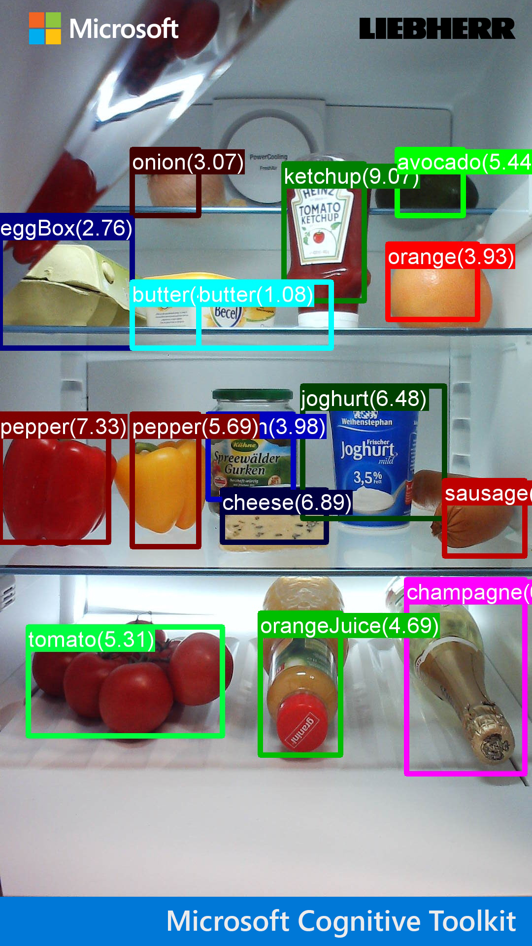
Computer Vision

Slide 36
Two Content Layout with Table
First bullet point here
Second bullet point here
Third bullet point here
Class | Group A | Group B
Class 1 | 82 | 95
Class 2 | 76 | 88
Class 3 | 84 | 90

Slide 37
Two Content Layout with SmartArt
Group A
Task 1
Task 2
Group B
Task 1
Task 2
Group C
Task 1
First bullet point here
Second bullet point here
Third bullet point here

Slide 38
Add a Slide Title - 1

Slide 39
Add a Slide Title - 2

Slide 40
Add a Slide Title - 3

Slide 42
Add a Slide Title - 4

Slide 43
Add a Slide Title - 5

